Slide 1
Beta Probabilistic
Databases
A Scalable Approach to Belief Updating and Parameter Learning
Niccolò Meneghetti
HPE Vertica
Oliver Kennedy
SUNY Buffalo
Wolfgang Gatterbauer
Carnegie Mellon University

Slide 2

The big picture: Training from sampled query-answers
evidence
relational structure
Do Ada and Bob work for the same company?
yes yes yes no yes no no …
Does Ada have a job?
no yes yes no no yes …
Does Bob work for HP?
no no no no yes no no …
probabilistic model
β
2

Slide 3
Background: Provenance / Lineage
3

Slide 4
Background: Tuple-independent PDBs
Each tuple (x) is annotated with a probability (θ)
A possible world (W) consists of a subset of tuples:
4

Slide 5
Background: Tuple-independent PDBs
The probability associated with Boolean query (q) is the probability of drawing a possible world where the query is satisfied
Does Ada have a job?
5

Slide 6
Background: Tuple-independent PDBs
If the lineage of a query q is read-once, then its marginal probability admits a polynomial factorization*
  negation:
  independent conjunction:
  independent disjunction:
Does Ada have a job?
*Dan Olteanu and Jiewen Huang. 2008. Using OBDDs for Efficient Query Evaluation on Probabilistic Databases. SUM '08.
6

Slide 7
The big picture: Training from sampled query-answers
evidence
relational structure
Do Ada and Bob work for the same company?
yes yes yes no yes no no …
Does Ada have a job?
no yes yes no no yes …
Does Bob work for HP?
no no no no yes no no …
probabilistic model
β
7

Slide 8
The big picture: Training from sampled query-answers
evidence
relational structure
x₁x₃?
true true true false true false …
x₁ v x₂ ?
false true true false false true …
x₃ ?
false false true false …
probabilistic model
β
8

Slide 9
Beta Probabilistic Databases
Key idea: we impose a Beta prior on each tuple
Std TI-PDB:
θ
x
Beta PDB:
a
θ
x
b
Notes:
What is a P-Skyline query

Slide 10
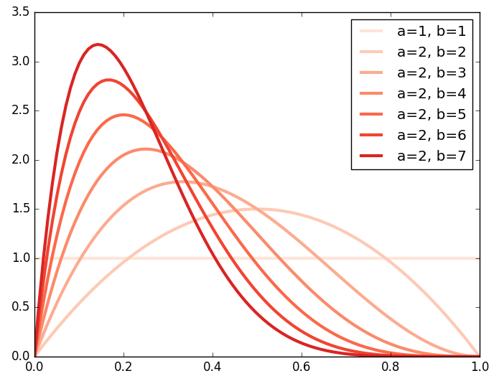
Background: The Beta Distribution
a
θ
b
10

Slide 11
Background: The Beta-Bernoulli Compound Distribution
a
θ
x
b
11

Slide 12

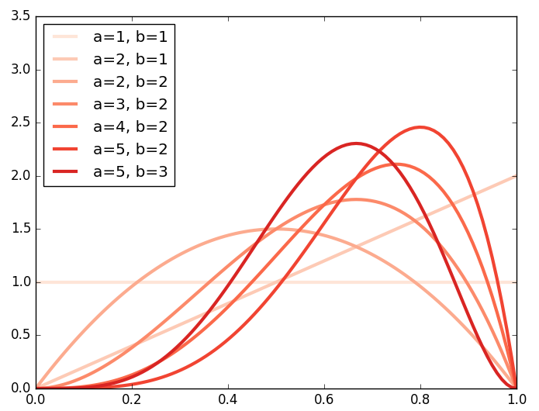
Example: Coin Tosses
Simple BU Algorithm:
Observe a new sample
Compute the posterior
Adjust the prior so to match the posterior
Go to Step 1
a
θ
x
b
a | b | <θ> | h[θ] | obs.
1 | 1 | 0.5 | 0 | head
2 | 1 | 0.667 | -0.193 | tail
2 | 2 | 0.5 | -0.125 | head
3 | 2 | 0.6 | -0.235 | head
4 | 2 | 0.667 | -0.362 | head
5 | 2 | 0.714 | -0.484 | tail
5 | 3 | 0.625 | -0.430 | …
12

Slide 13
The big picture: Training from sampled query-answers
evidence
relational structure
x₁x₃?
true true true false true false …
x₁ v x₂ ?
false true true false false true …
x₃ ?
false false true false …
probabilistic model
β
13

Slide 14
B-PDBs: Incorporating a single additional observation
exists(select * from R where emp=‘HP’) ? false
How would we adjust the parameters if the answer was “true” ?
14

Slide 15
B-PDBs: BU algorithm
How would we adjust the parameters if the answer was “true” ?
Revised BU Algorithm:
Observe a new query-answer
Compute the marginal posteriors
Adjust the priors so to match the marg. posteriors
Process the next sample
15

Slide 16
B-PDBs: Conditional and Posterior Probabilities
Conditional probabilities
Example: given that Ada is employed, what is the probability that she works for HP?
Posterior probabilities
Example: if someone tells us that Ada is employed, how this affects our beliefs about the parameters’ vector θ ?
16

Slide 17
B-PDBs: Marginal Posterior
Posterior probabilities
Example: if someone tells us that Ada is employed, how this affects our beliefs about the parameters’ vector θ ?
Marginal posterior
Example: if someone tells us that Ada is employed, how this affects our beliefs about the component of θ associated with the tuple (Ada, HP) ?
17

Slide 18
B-PDBs: Incorporating a single additional observation
Main result:
The i-th marginal posterior depends only on the prior associated with the i-th tuple, and its marginal probability conditioned by the evidence
The marginal posterior is not a Beta distribution, hence it is not a conjugate prior
The marginal posterior is a mixture of Beta distributions
18

Slide 19
B-PDBs: Incorporating a single additional observation
How to adjust the prior so to match the posterior?
  They do not belong to the same family
  We minimize the relative entropy between the two
The Beta distribution belongs to the exponential family and its natural statistics are log(θ) and log(1-θ)
Hence, to minimize the relative entropy we need to identify the hyper-parameters a* and b* that satisfy the following constraint:
19

Slide 20
B-PDBs: Generalizing to multiple observations
Plate model
k distinct Boolean queries / lineage formulas
s independent observations per query
GOAL: collapsing multiple observations into a single BU step
20
Notes:
What is a P-Skyline query

Slide 21
The big picture: Training from sampled query-answers
evidence
relational structure
x₁x₃?
true true true false true false …
x₁ v x₂ ?
false true true false false true …
x₃ ?
false false true false …
probabilistic model
β
21

Slide 22
The big picture: Training from sampled query-answers
evidence
relational structure
x₁x₃?
true with prob .7
x₁ v x₂ ?
true with prob .4
x₃?
true with prob .2 …
probabilistic model
β
22

Slide 23
B-PDBs: Maximum Likelihood Estimation
BU is a member of the EM family
  E-step: computation of the conditional probabilities
  M-step: minimization of the relative entropy between prior and marginal posterior
Each BU step increases the likelihood in a greedy fashion
Example:
(x₁ ^ x₂) is observed to be true 32 over 100 times
(x₁ v x₂) is observed to be true 88 over 100 times
Likelihood maxima are located at (.8,.4) and (.4, .8)
23

Slide 24
TI-PDBs: Complexity Results
Probabilistic inference in TI-PDBs is tractable for conjunctive self-join free hierarchical queries [*]
A non-Boolean query can be seen as a collection of Boolean queries, one per each output-record. If the query is conjunctive, hierarchical and self-join free, then the lineage of each output-tuple is read-once [**]
The derivative of a marginal probability can be expressed itself as a read-once formula [***]
*Nilesh N. Dalvi, Dan Suciu:
The dichotomy of probabilistic inference for unions of conjunctive queries.
J. ACM 59(6): 30:1-30:87 (2012)
**Dan Olteanu and Jiewen Huang. 2008. Using OBDDs for Efficient Query Evaluation on Probabilistic Databases. In Proceedings of the 2nd international conference on Scalable Uncertainty Management (SUM '08)
***Bhargav Kanagal, Jian Li, and Amol Deshpande. 2011. Sensitivity analysis and explanations for robust query evaluation in probabilistic databases. In Proceedings of the 2011 ACM SIGMOD International Conference on Management of data (SIGMOD '11)
24

Slide 25
B-PDBs: Complexity of Belief Updates
We combine those results and prove that
If the evidence consists of answers to conjunctive self-join-free hierarchical queries, then each belief updating step takes polynomial time in the size of the query
25

Slide 26
B-PDBs: Recap
B-PDBs generalize TI-PDB by applying Beta priors
B-PDBs are equivalent to TI-PDBs w.r.t. probabilistic inference
B-PDBs supports belief updating w.r.t. sampled answers to Boolean queries
Belief Updating is performed in a well-founded, unbiased fashion
Belief Updating takes polynomial time for conjunctive self-join-free hierarchical queries
Multiple BU steps will asymptotically converge to a maximum likelihood estimator
26

Slide 27
B-PDBs: Benchmarks
Maximilian Dylla, Martin Theobald, Iris Miliaraki:
Querying and Learning in Probabilistic Databases.
Reasoning Web 2014: 313-368
27

Slide 28
B-PDBs: Benchmarks
28

Slide 29
B-PDBs: Future work
29

Slide 30
Thank you!
(Questions?)

